Slide 1
Clean Code

Slide 2
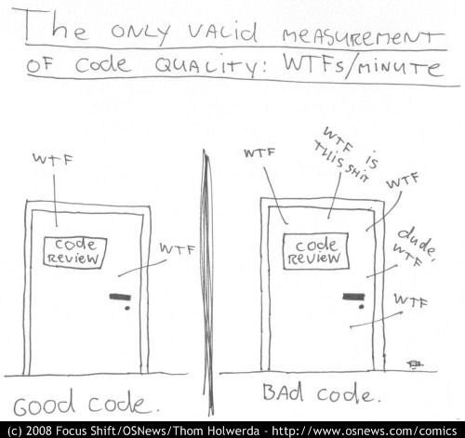
https://www.osnews.com/story/19266/wtfsm/

Slide 3
General Principles
Don’t write twice: one code bulk – one functionality, for all the code.
Use functions. Better yet: OOP (Classes)
Use clear names for variables, functions, classes, pages etc.
Use clear hierarchy
Use excepted code models
Use 2 build sprints to one refactoring sprint.

